Slide 1
AFRICA: Key issues review

Slide 2
Match each of the following statements correctly with the main content categories listed here:
AFRICAN HISTORY
SOMALIA/ INTERNATIONAL PIRACY
THE ERA OF COLONIALISM
NELSON MANDELA

Slide 3
AT THE START OF THE 20TH CENTURY, 90% OF AFRICA WAS CONTROLLED BY EUROPEAN NATIONS.

Slide 4
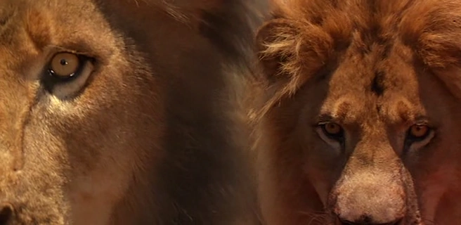
IN 1898, TWO ROGUE LIONS ATTACKED AND KILLED DOZENS OF AFRICAN LABORERS CONSTRUCTING A RAILROAD AND A RAILROAD BRIDGE ACROSS THE TSAVO RIVER IN CENTRAL KENYA. THE EVENTS OF THIS UNBELIEVABLE INCIDENT BECAME THE BASIS FOR A MOVIE CALLED THE GHOST AND THE DARKNESS.

Slide 5
AFTER SERVING 27 YEARS IN PRISON, BECAME SOUTH AFRICA’S FIRST-EVER BLACK PRESIDENT IN 1994.

Slide 6
THE HORN OF AFRICA

Slide 7
A NON-EXISTENT CENTRAL GOVERNMENT MEANS THERE IS NO LAW FORCE ON LAND TO DEAL WITH THIS ISSUE THAT HAS NOW BECOME A MAJOR MARITIME SHIPPING CONCERN.

Slide 8
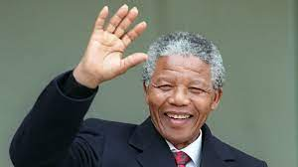
WORKED TO END THE OPPRESSIVE PRACTICE OF RACIAL SEGREGATION IN SOUTH AFRICA KNOWN AS APARTHEID

Slide 9

* U.S. MILITARY INTERVENTION IN 1993 TO PROTECT UNITED NATIONS FOOD AID AND ARREST A VIOLENT, MILITANT WARLORD; BASIS FOR THE MOVIE BLACK HAWK DOWN

Slide 10
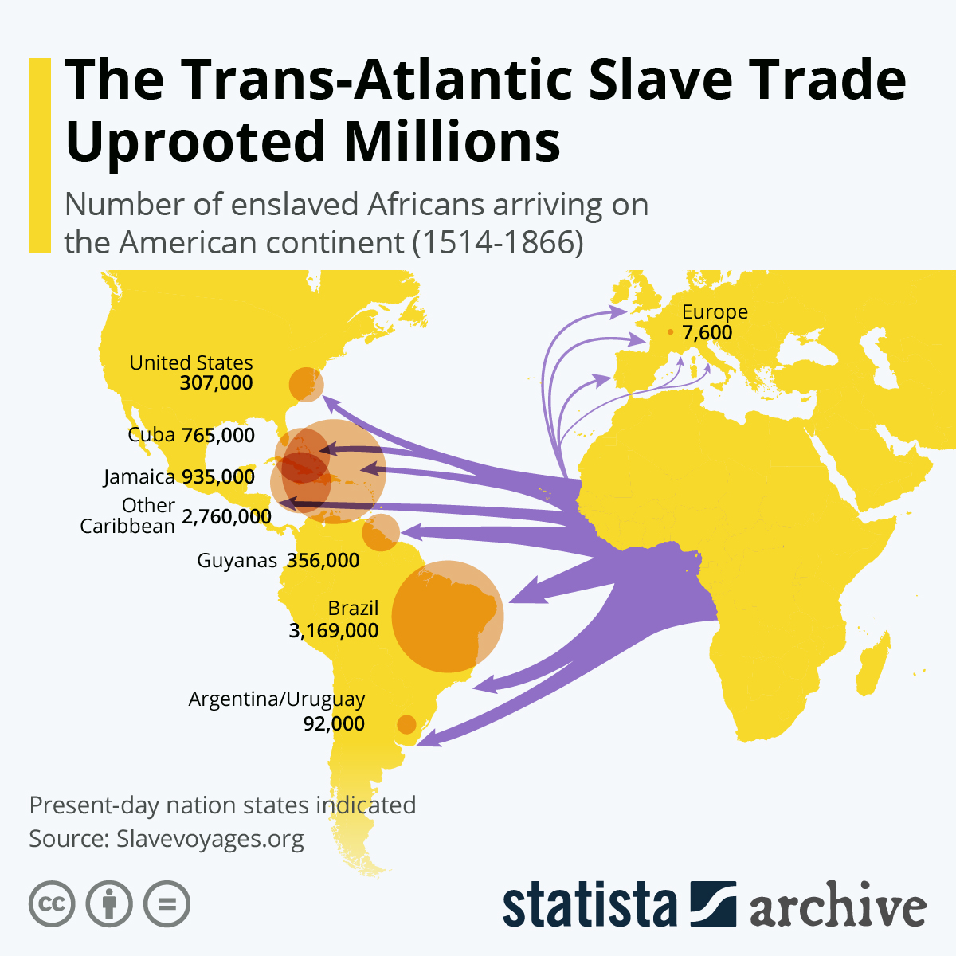
FROM THE 1500’s THROUGH THE MID-1800’S, AN ESTIMATED 12 MILLION AFRICAN PEOPLE WERE SOLD INTO SLAVERY TO EUROPEAN SLAVE TRADERS AND SENT ON SHIPS TO SOUTH AMERICA, CENTRAL AMERICA, THE CARIBBEAN, THE 13 BRITISH COLONIES, AND THE UNITED STATES.

Slide 11
WIDESPREAD FAMINE, CIVIL WARS, DISPUTING WARLORDS, GOVERNMENT ANARCHY, PROLONGED PERIODS OF SEVERE DROUGHT, DEVASTATED INFRASTRUCTURE, EXTREME ECONOMIC POVERTY

Slide 12
CURRENT NATIONAL BOUNDARIES REFLECT POLITICAL AGREEMENTS BETWEEN VARYING EUROPEAN NATIONS WHO COLONIZED AFRICA DURING THE 15TH AND 16TH CENTRURIES.

Slide 13
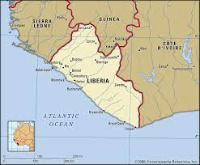

LIBERIA, WHICH IS BASED ON THE LATIN WORD “LIBER,” WHICH MEANS “FREE,” WAS FOUNDED IN 1847 BY THE UNITED STATES AS A SAFE PLACE FOR FREED AFRICAN SLAVES.

